Slide 1
Music boxes from MIDI
Wei-Wei Lu, Trevor Walker

Slide 2
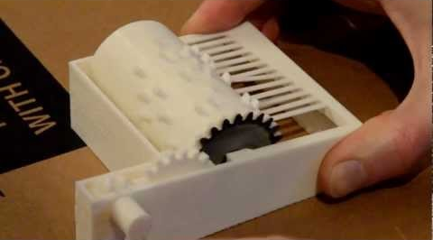
Problem and Motivation
Inspired by project idea shown in class
Custom music boxes traditionally costly
Manual note and scale input is tedious
MIDI encodes all necessary information
Plastic comb sounds bad
Computational fabrication techniques work with other materials too

Slide 3
Background and Tools
Major music box parts and their functions
Cylinder (notes/timing)
Comb (scale)
Clockwork mechanism (tempo)
OpenSCAD
Parametric description of part → printable STL
Applying skills learned from assignment 2

Slide 4
Technical Method: Generation
Front end: JavaScript web app
User access is easy
No external libraries or installation required
Back end: OpenJSCAD
JavaScript wrapper for OpenSCAD
JS code determines low-level parameters, then passes them to SCAD routine
User parameters
Which MIDI track to use
Which portion of song to encode on cylinder

Slide 5
Technical Method: Fabrication
Cylinder and mechanism: 3D printed ABS/PLA
Feasibility already shown
Gears and mechanisms are common
Comb: Laser cut stainless steel
Sounds much better than plastic
Very thin metal is possible to laser cut
Dimensions can be matched to known acoustic properties of alloy

Slide 6
Expected results
Web app for generating printable files
Only necessary parameters exposed
Produces downloadable STL/OBJ for printing and SVG/DXF for laser cutting
Functional music boxes
Demonstrated during final presentation

